Slide 1
Homework 2
Simulation of Complex Systems
Francisco Caetano

Slide 2
Exercise 1
128x128-lattice
p: probability of an empty site to turn into an occupied one
Increasing p leads to denser forests (bigger fires)
Decreasing p leads to low density forests (smaller fires)
f: probability of a lightning strike occurring at a random site
Increasing f causes more fires per time step (it can delay the growth of a forest)
Decreasing f causes less fires per time step (but it allows forests to become denser)

Slide 3
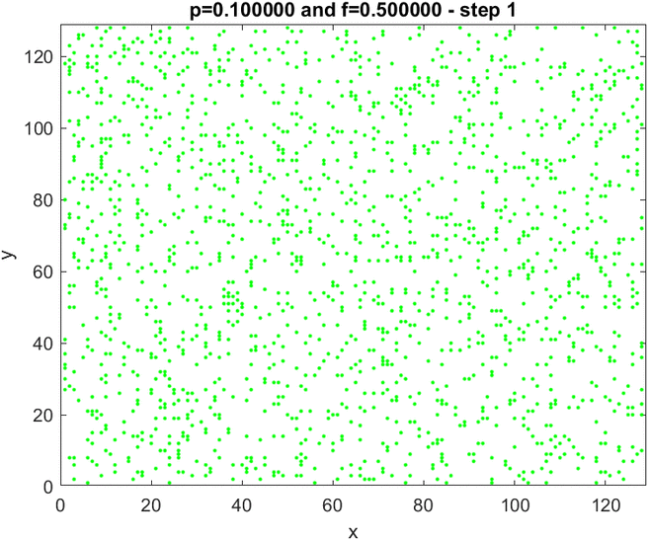
Low p and Low f

Slide 4
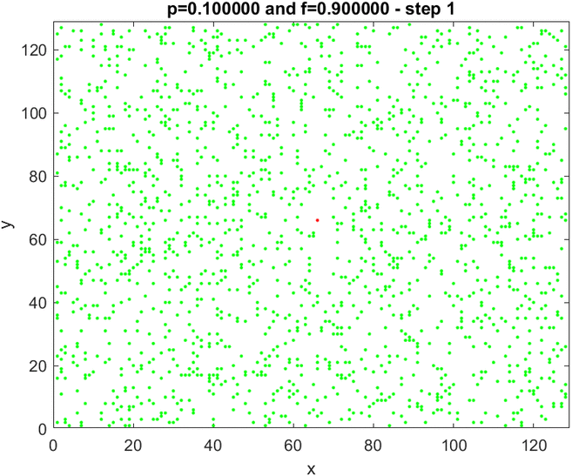
Low p and High f

Slide 5
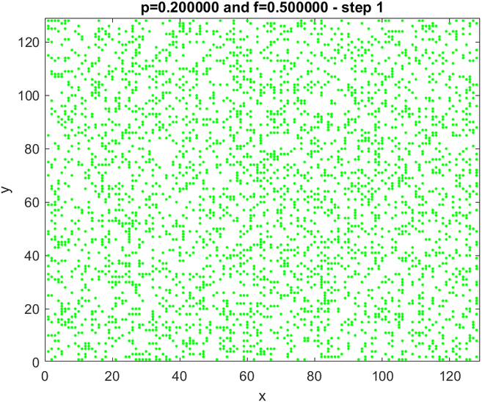
High p and Low f

Slide 6
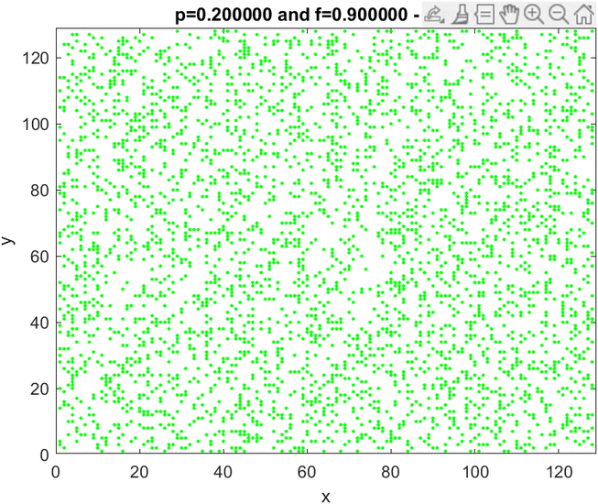
High p and High f

Slide 7
Exercise 2
128x128-lattice
Rank-frequency plot of forest grown with fires (clusters will start to emerge more frequently, small fires (0.001 ratio) become less probable as the forest grows)
Rank-frequency plot of forest grown without fires (random distribution of the trees, no relevant patterns)

Slide 8
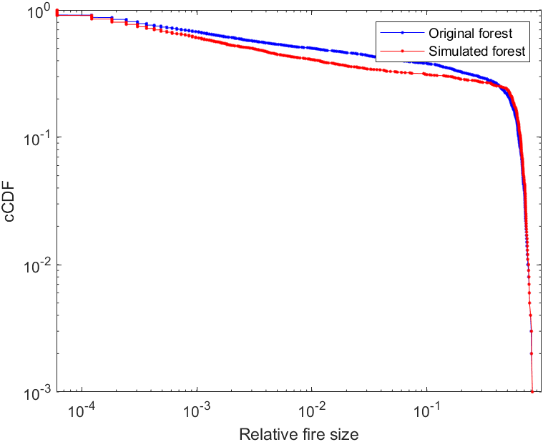
Rank-frequency plots

Slide 9
Exercise 3
Rank-frequency plot with the fire data and the linear fit used to find the exponent τ
Find the limits for which linear approximation is valid
Determine τ
Rank-frequency plot comparing the fire data and the synthetic power law data.

Slide 10
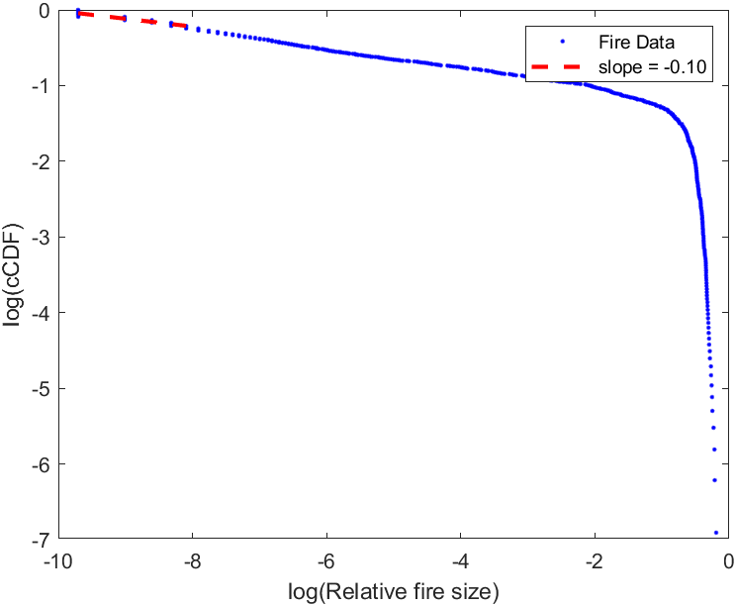
Limits

Slide 11
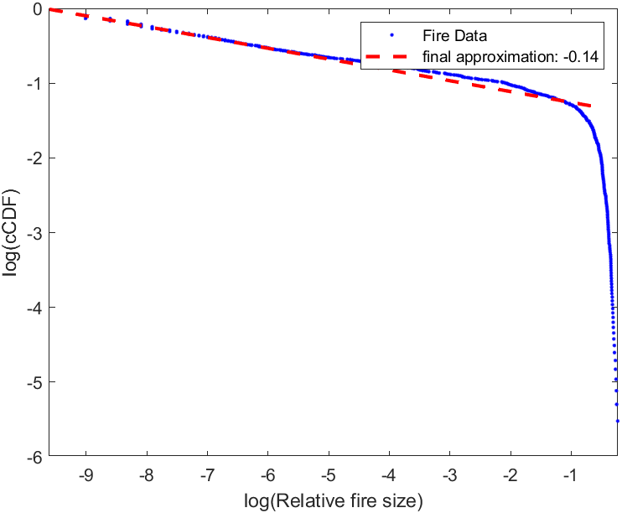
Determine τ

Slide 12
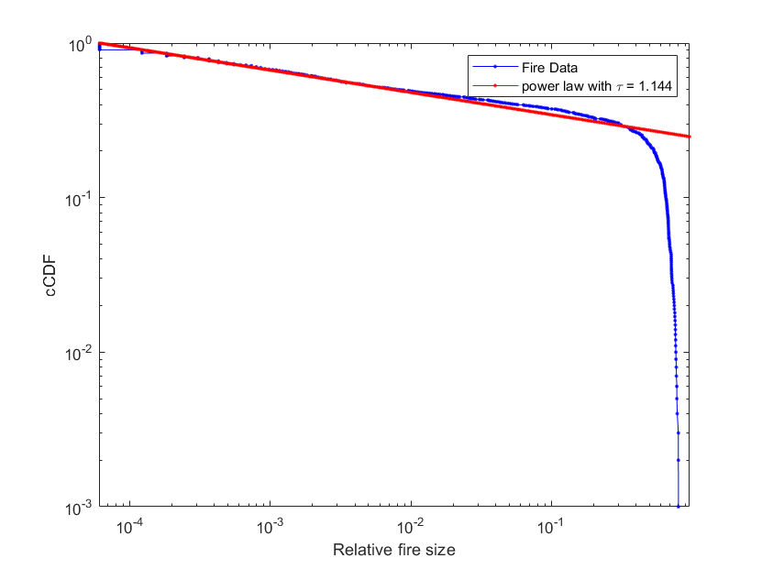
Rank-frequency plot

Slide 13
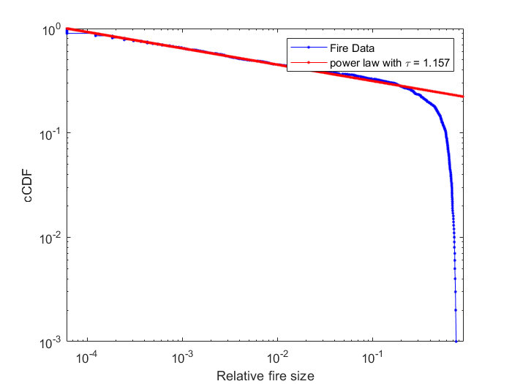
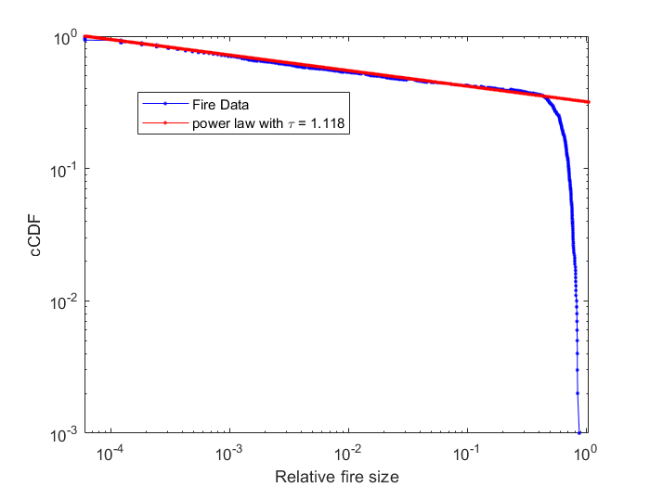
Is the result sensitive to the choice of parameters p and f?
Increase f (to 0.9): increases τ
Reduce F (to 0.5): decreases τ

Slide 14
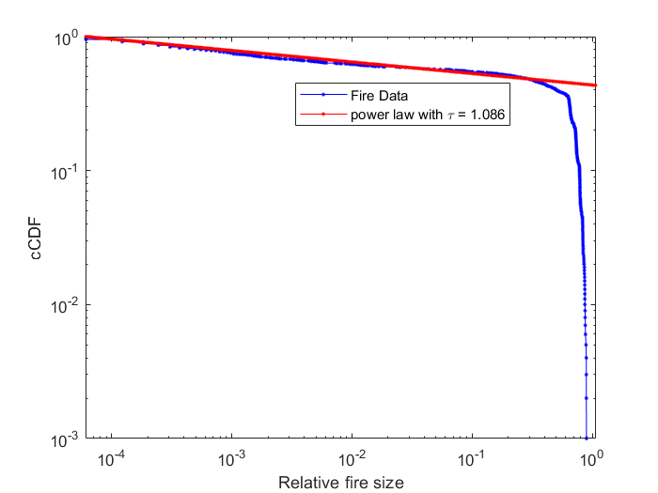
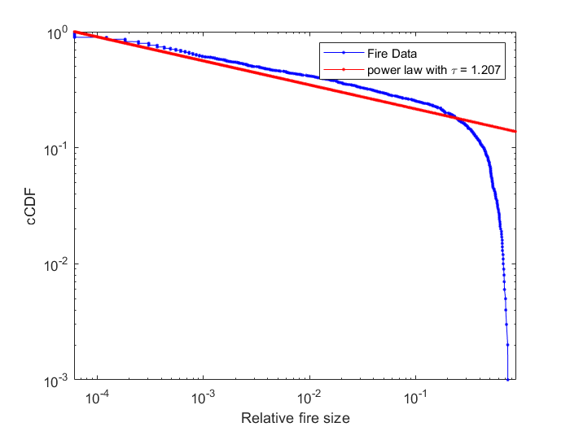
Is the result sensitive to the choice of parameters p and f?
Increase p (to 0.2): decreases τ
Reduce P (to 0.05): increases τ

Slide 15
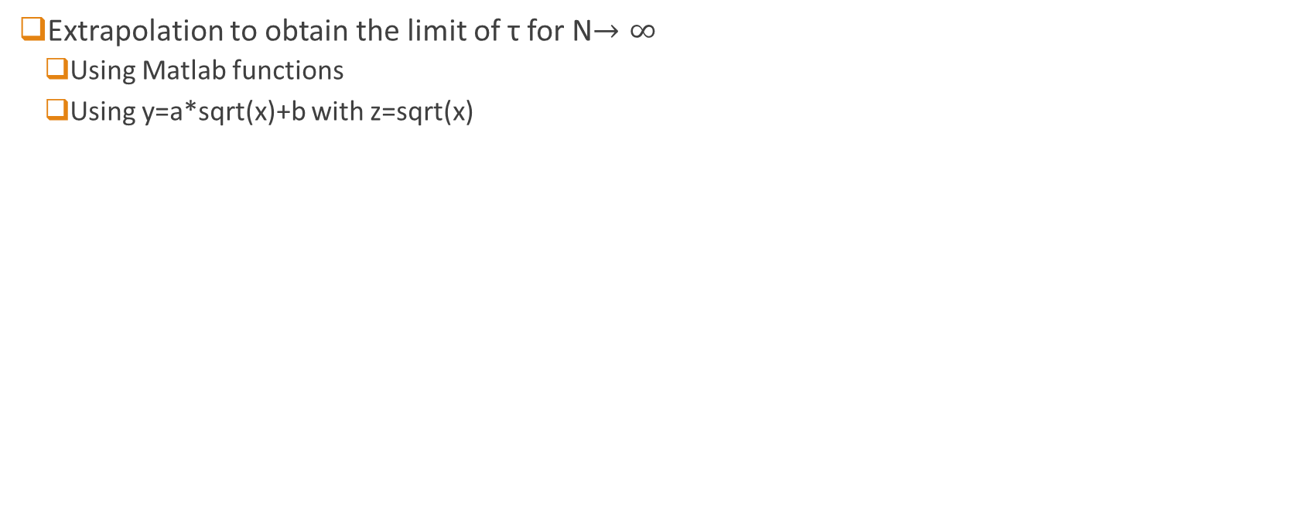
Exercise 4
Extrapolation to obtain the limit of τ for N$→∞$
Using Matlab functions
Using y=a*sqrt(x)+b with z=sqrt(x)

Slide 16
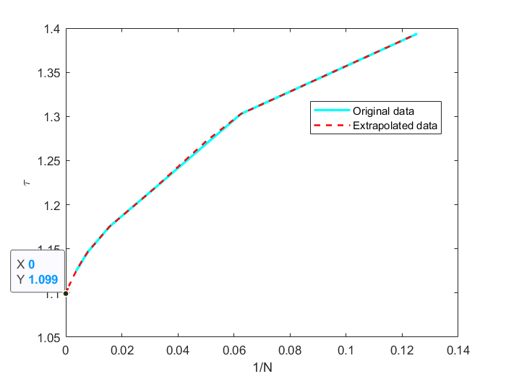
Extrapolation using polynomial approximation

Slide 17
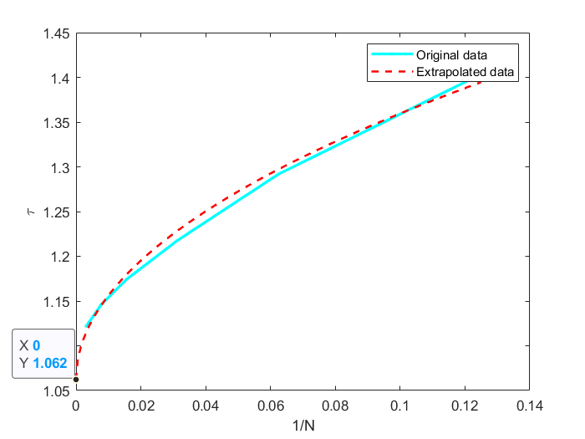
Extrapolation using y=a*sqrt(x) + b

Slide 18
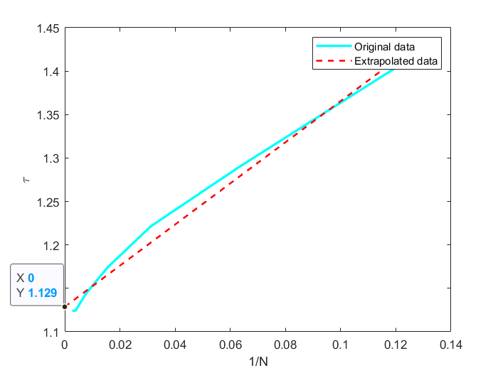
Linear Fit

